Slide 1
Robot Arm control procedure
Turn on the ESP32 Board
Connect to wifi– SSID: Eric_Arm Password:12345678
Open browser(chrome/edge) and visit 192.168.4.1
Turn on the gamepad, connect to the pc, press any botton, then a visualization of
the gamepad will show up on the bottom of the webpage, indicate successful connect.
5. Can start to control the robot arm using gamepad

Slide 2
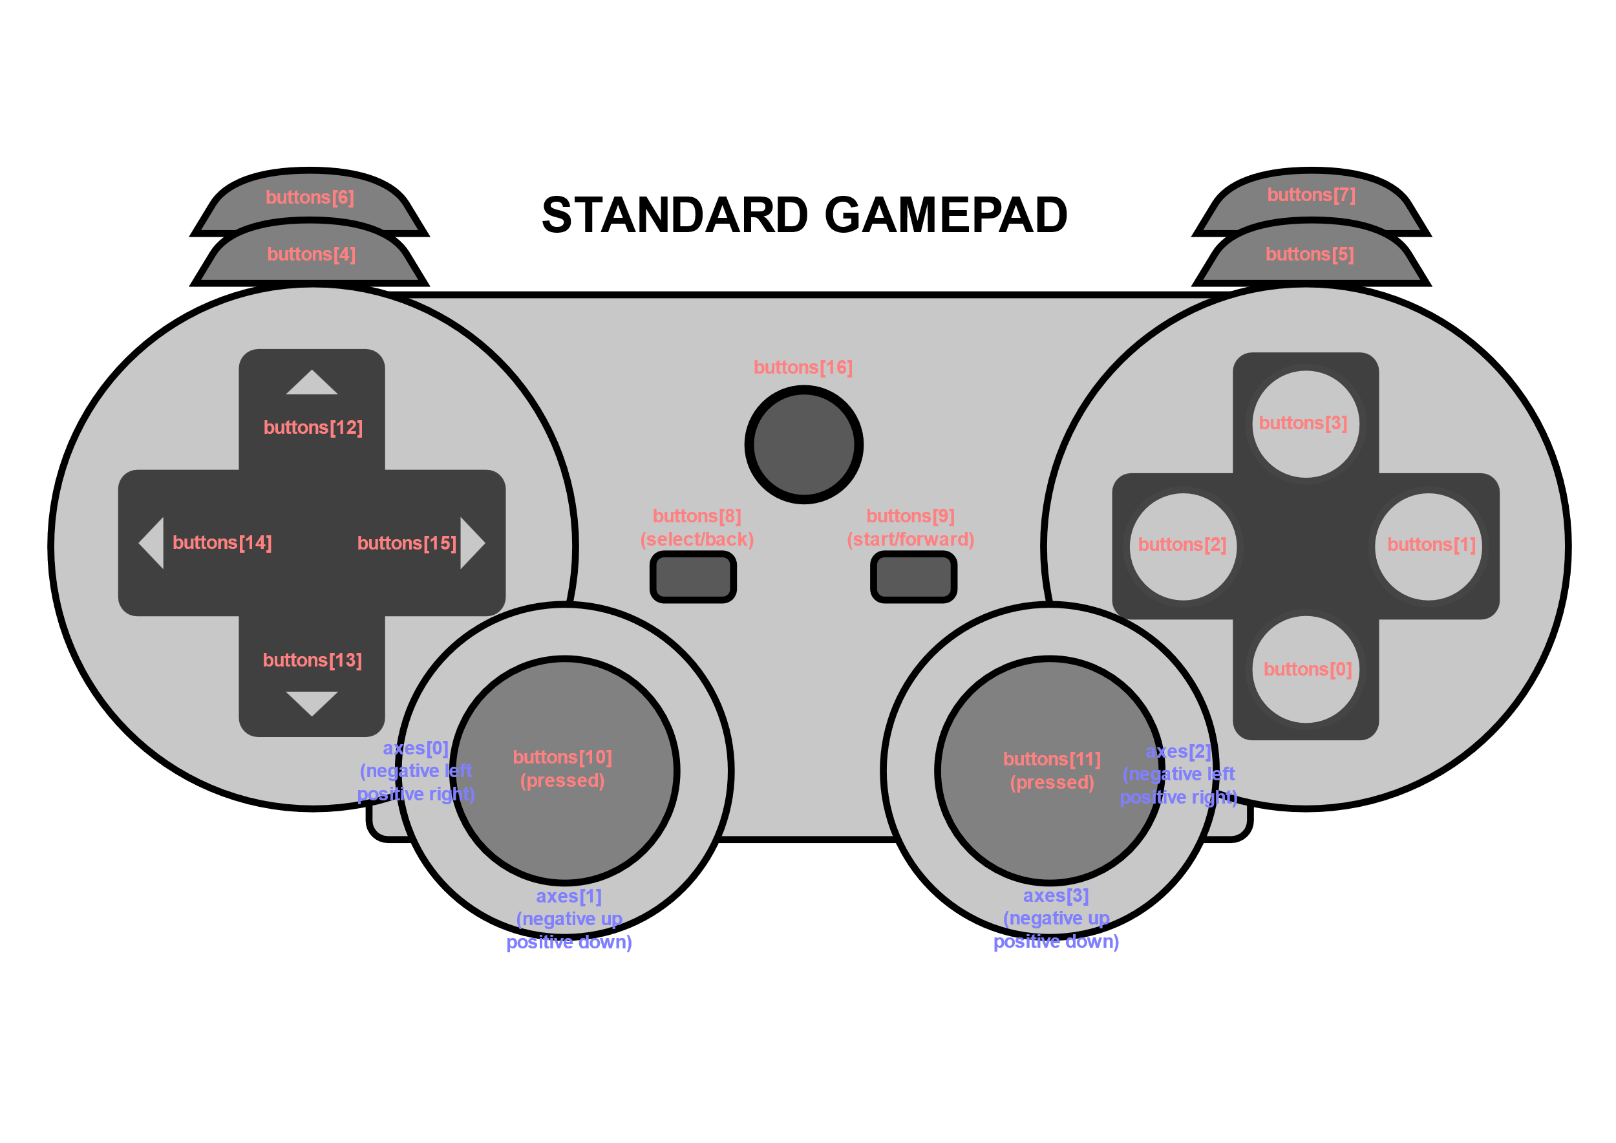
Move to Default pos
(Init Pos)
Use webpage to
preset the positions
Wrist up/down
Move to Preset Pos 1
Move to Preset Pos 2
Gripper Spin
Elbow up/down
Gripper open/close

Slide 3
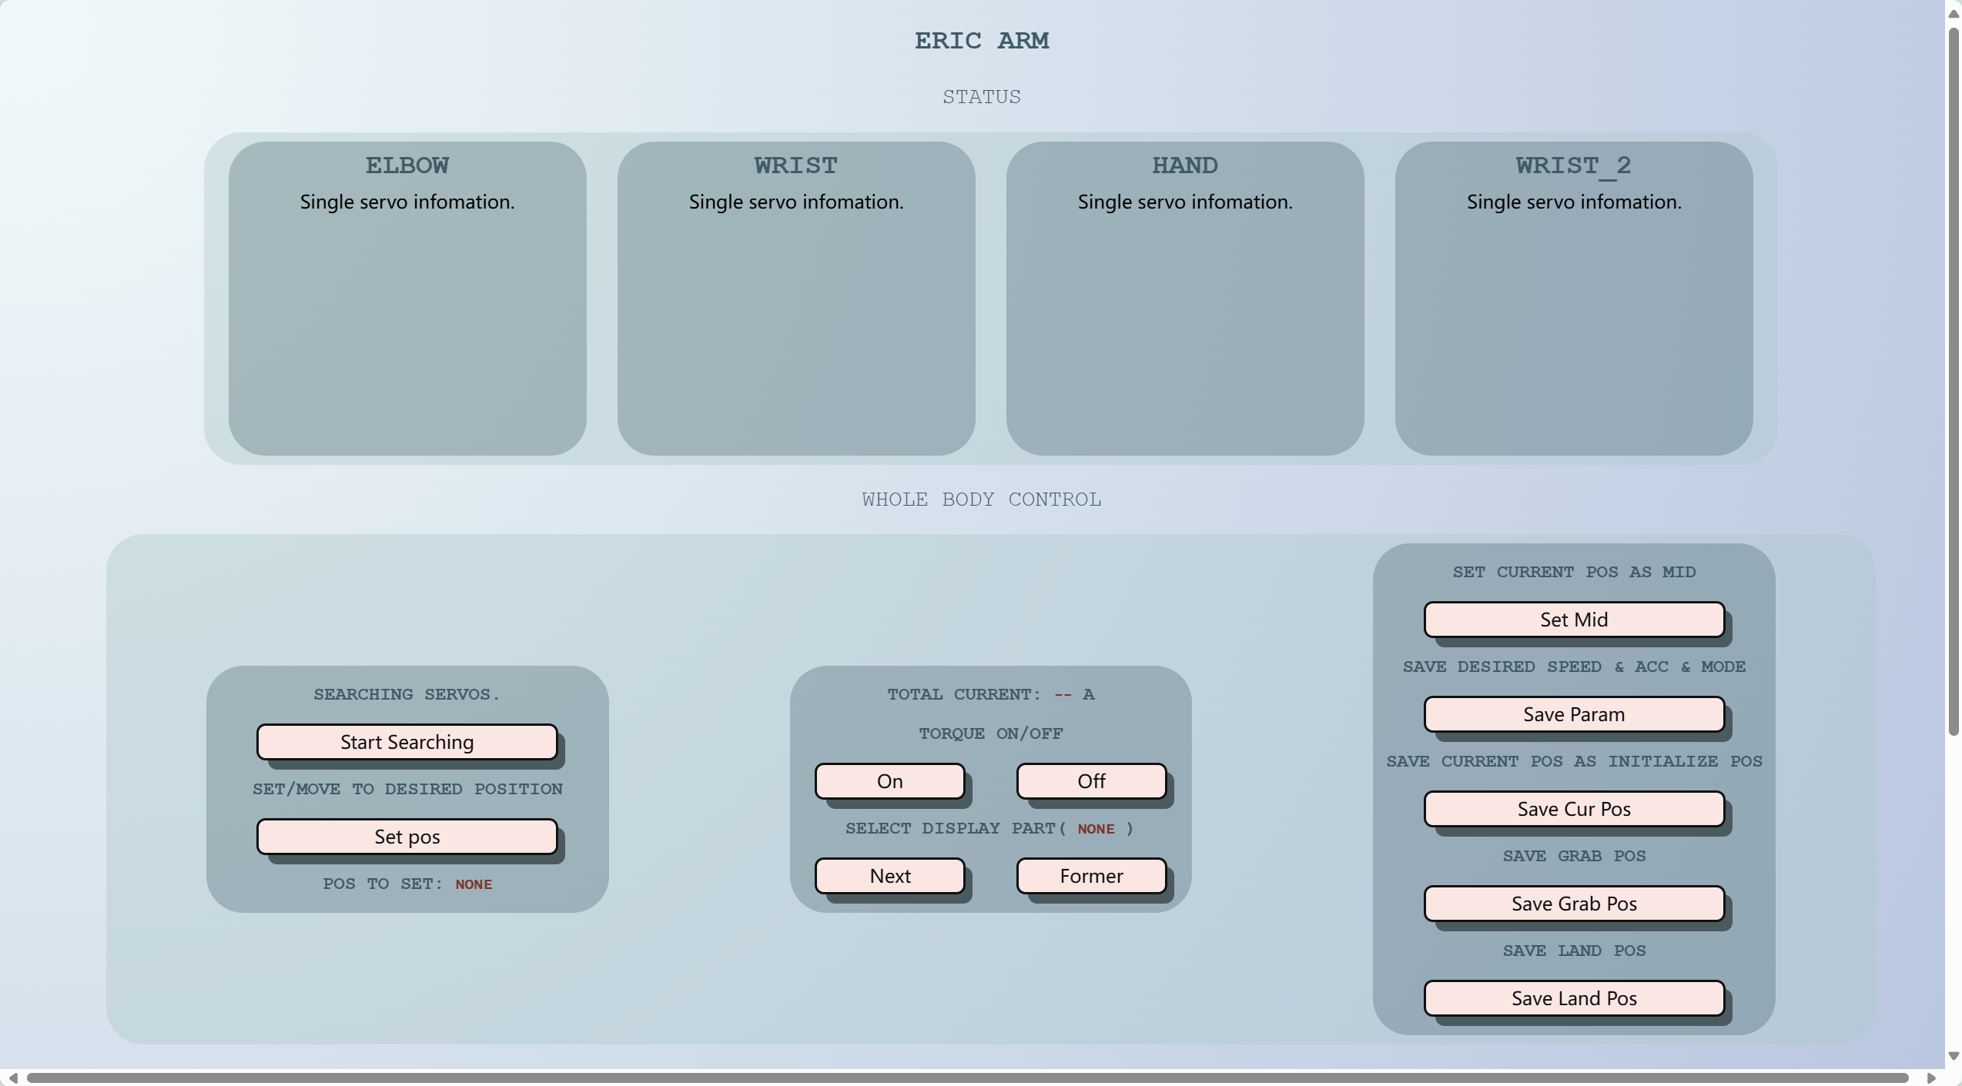
Web page:

